Slide 1
IDL Strategy
Making Connections in learning

Slide 2
Thinking Skills
Thinking Skill | Words you might hear or use when thinking and talking about this skill | What could this look like when you are planning for learning? Give examples of structures or activities you might use:
Creating | Compose, assemble, organise, invent, compile, forecast, devise, propose, construct, plan, predict, improve, formulate, generate, prepare, develop, design, imagine, set up, create, produce
Evaluating | Judge, predict, assess, determine, prioritise, experiment, check, test, evaluate, defend, conclude, debate, justify, recommend, discriminate, argue, rank
Analysing | Distinguish, inspect, inquire, question, examine, research, probe, investigate, calculate, experiment, compare, contrast, survey, test, debate, sequence, relate, categorise, discriminate
Applying | Translate, illustrate, make, practice, manipulate, calculate, apply, operate, exhibit, interpret, interview, sequence, show, solve, collect, demonstrate, dramatise, use, adapt, draw, construct
Understanding | Report, recognise, review, describe, observe, outline, interpret, explain, identify, discuss, research, annotate, translate, give examples, define
Remembering | List, memorise, choose, recite, quote, record, match, select, underline, cite, relate, sort, show, locate, give an example, reproduce, quote, repeat, label, recall, outline

Slide 3
Useful docs
file:///C:/Users/aileenmc/OneDrive%20-%20The%20Highland%20Council/My%20Documents/SQIO/DYW/Career%20Education%20Standard%20Learning%20Resource.pdf

Slide 4
By end of First Level: to the end of P4, but earlier or later for some.
• I can describe different jobs in my community and some of the skills needed for these.
• I can learn about the world of work from visits, projects and my experiences.
• I can talk to employers about myself and about their workplace.
• I can recognise that there are different ways to get a job.
• I can talk about the types of jobs that interest me.
• I believe I can succeed in any area of work.
• I can talk about my strengths, interests and skills and show evidence of my progress.
• I can set goals and work towards achieving them.
• I can adopt different roles when running a business.
By end of Second Level: to the end of P7, but earlier or later for some.
• I can discuss the relevance of skills to the wider world and make connections between skills and the world of work.
• I can explain to others my ambitions/what I would like to do and look for ways to achieve them/that.
• I can recognise the skills I have and need for work.
• I can apply my skills to get more information about jobs/careers.
• I can use online tools available to me.
• I own and can manage my profile and can use it to help me discuss my interests, strengths and skills with my parents/carers and others.
• I can identify people in my network who help me broaden my horizons.
• I believe I can maximise my potential in any type of work.
• I can identify different types of enterprise opportunities and engage in them.

Slide 5
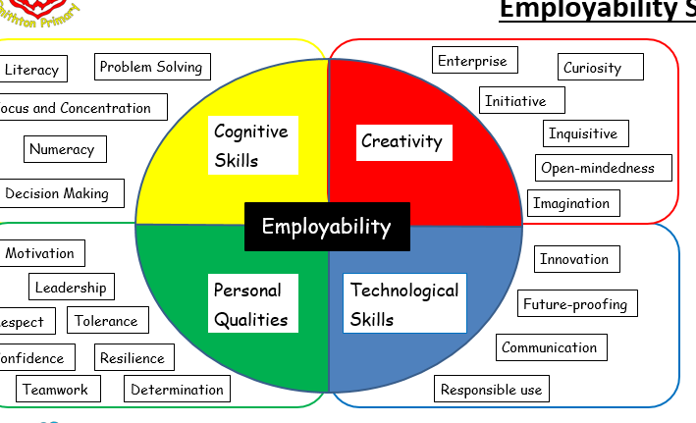

Slide 6
From Education Scotland: A Thought Paper
IDL is Learning
More than just “engagement”: deep thinking and deep learning
A common misconception is that IDL is just project work to be done after the ‘serious’ work of learning knowledge and skills has been done. It is perceived as a consolidator of learning, not a vehicle for learning new knowledge and skills in its own right. It might even be seen as one tool to engage learners, while the real work gets done elsewhere.
Quality interdisciplinary learning is none of that. Interdisciplinary learning is learning - it is a way of learning and thinking, and is challenging for learners. The challenge is personalised, owned by the learner, and so intrinsic engagement is higher than in a more traditional one-size-fits-all experience. Attendance at schools has improved as a result of engaging in this more personalised, more challenging approach to learning. Engagement and attainment have improved, too.
IDL relies on learners developing certain skills over the long haul, if they are to be able to seek out different ways to tackle a project or topic, for themselves, and not one set path defined by the practitioner.

